Slide 1
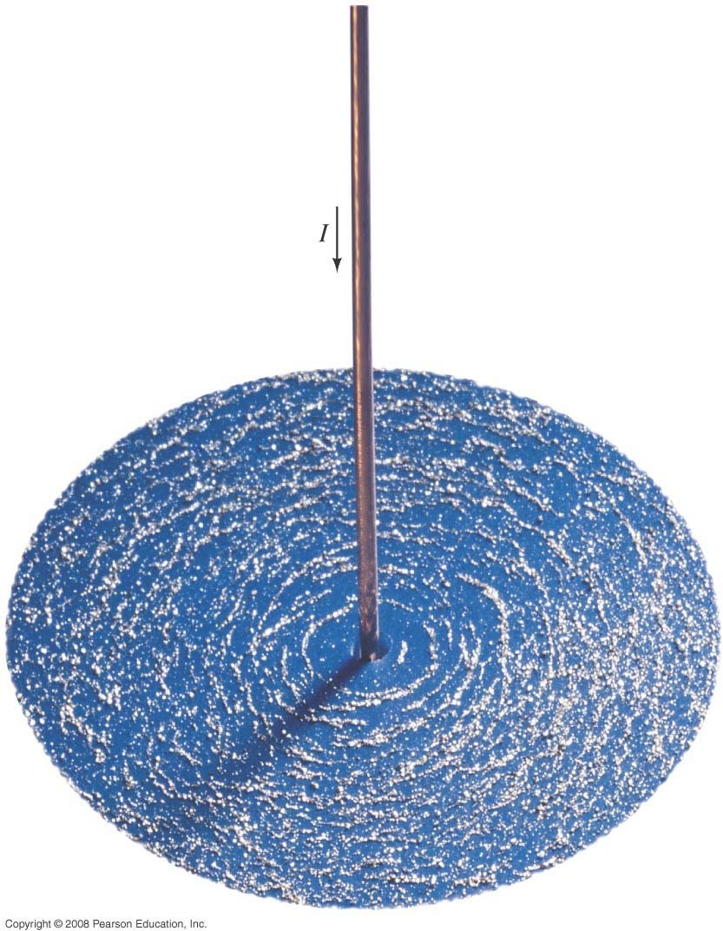

Slide 2
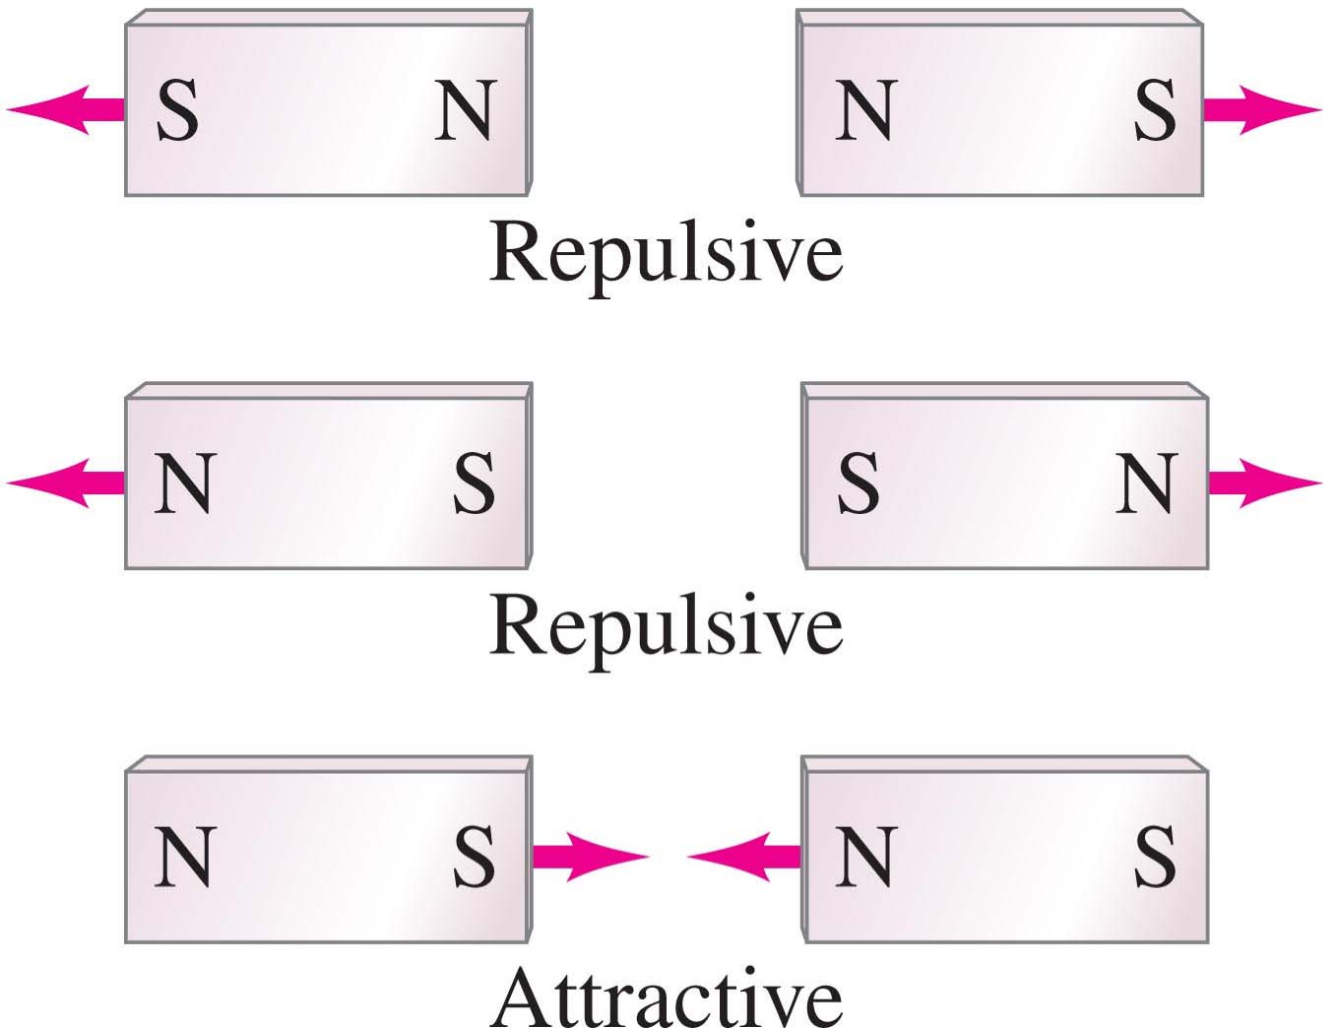
Magnets and Magnetic Fields
Magnets have two ends – poles – called north and south.
Like poles repel; unlike poles attract.

Slide 3
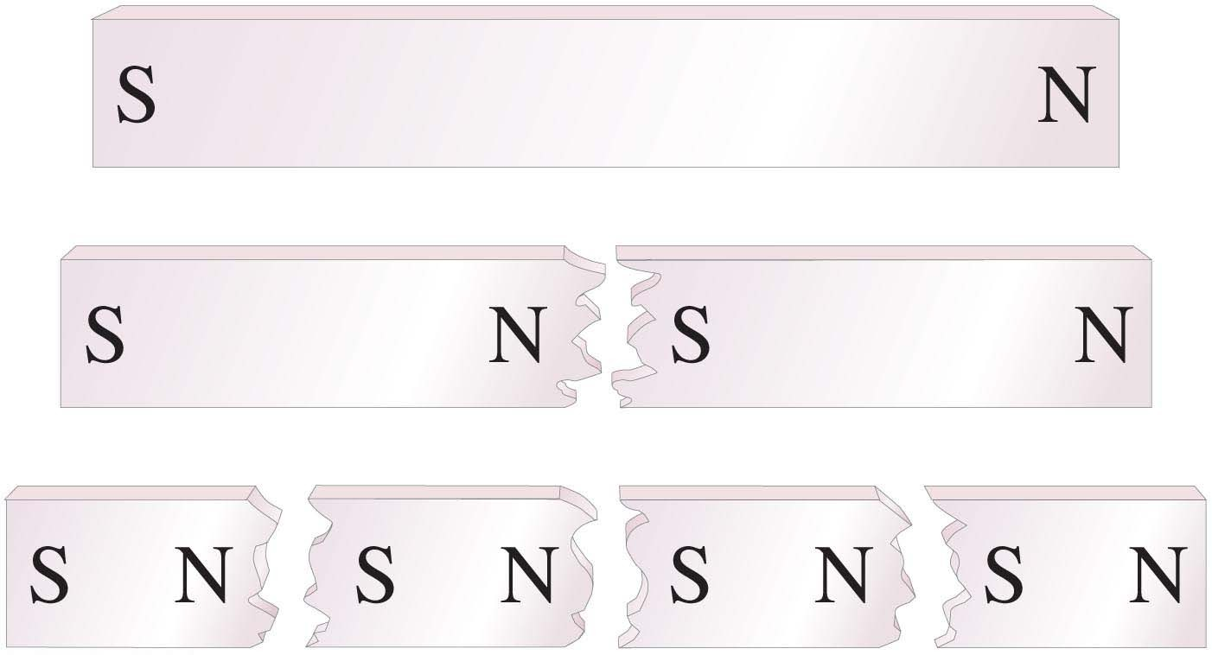
27-1 Magnets and Magnetic Fields
However, if you cut a magnet in half, you don’t get a north pole and a south pole – you get two smaller magnets.

Slide 4
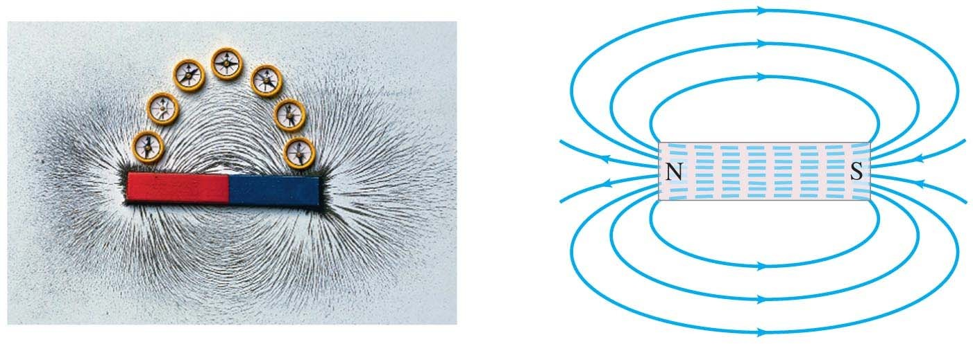
27-1 Magnets and Magnetic Fields
Magnetic fields can be visualized using magnetic field lines, which are always closed loops.

Slide 5
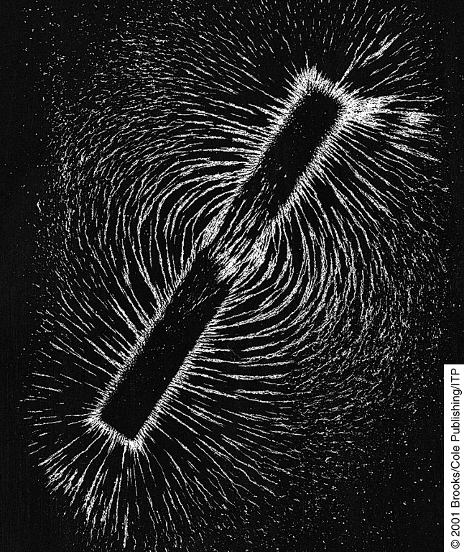
Magnetism Plays a Major Role
On the structure of the Sun
and important on Earth Here Iron filings are Sprinkled about a Magnet and
We get a sense of what Is happening
Around the space of The magnet
FILM: MAGNET AND IRON FILINGS
FILM 3D FIELD

Slide 6
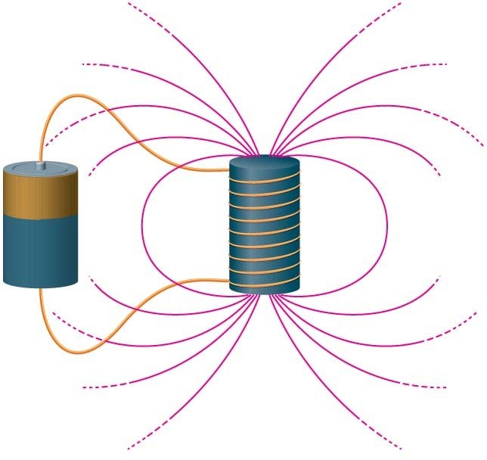
Sources of Magnetic Fields
Motions of charged particles are what create magnetic fields
In Planets and the Sun and in devices!
We use this for many applications

Slide 7
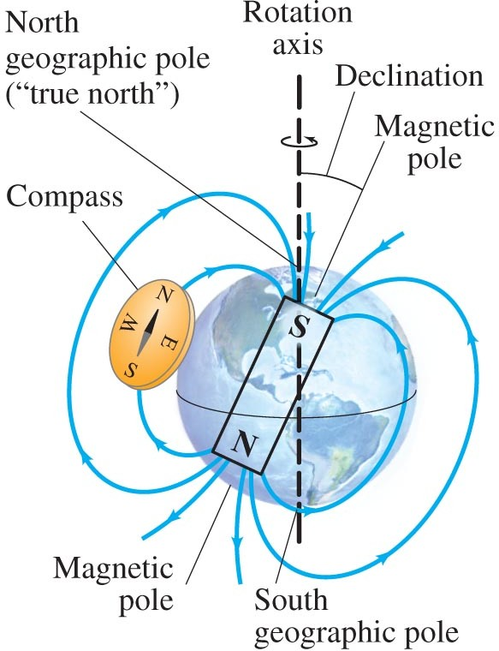
27-1 Magnets and Magnetic Fields
The Earth’s magnetic field is similar to that of a bar magnet.
Note that the Earth’s “North Pole” is really a south magnetic pole, as the north ends of magnets are attracted to it.

Slide 8
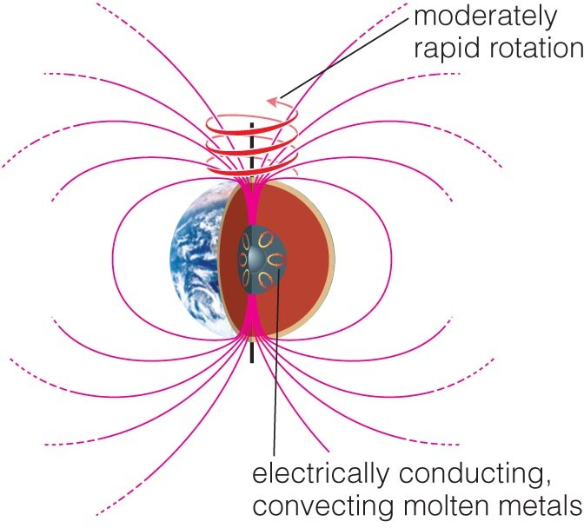
Sources of Magnetic Fields
A planet can have a magnetic field if charged particles are moving inside
3 requirements:
Molten interior
Convection
Moderately rapid rotation

Slide 9
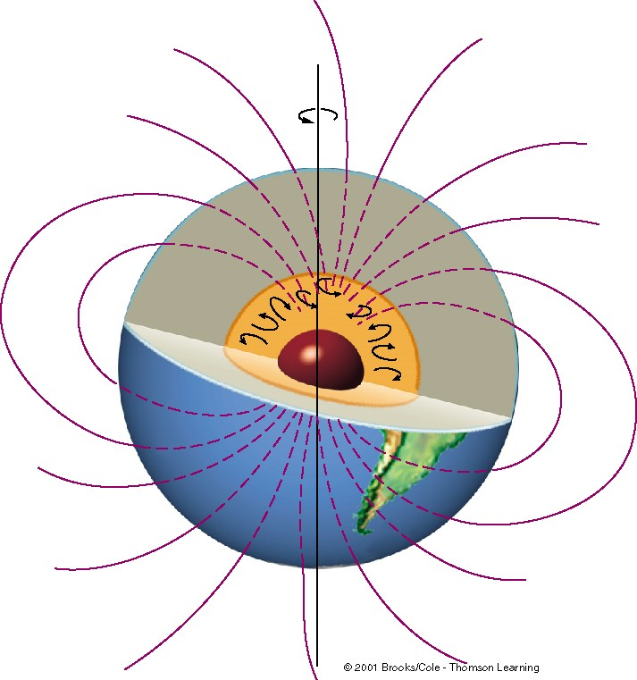
Earth’s MAGNETIC FIELD
SHIELDS UP!
SOLAR WIND IS COMING!
Earth rotates Rising heat
Causes convection In liquid core.
Which is a
Highly electrically conductive
Iron-nickel alloy
DYNAMO EFFECT
=rotation of convecting conducting liquid generates the
dipole magnetic field
Copyright © 2009 Pearson E
ducation, Inc.

Slide 10
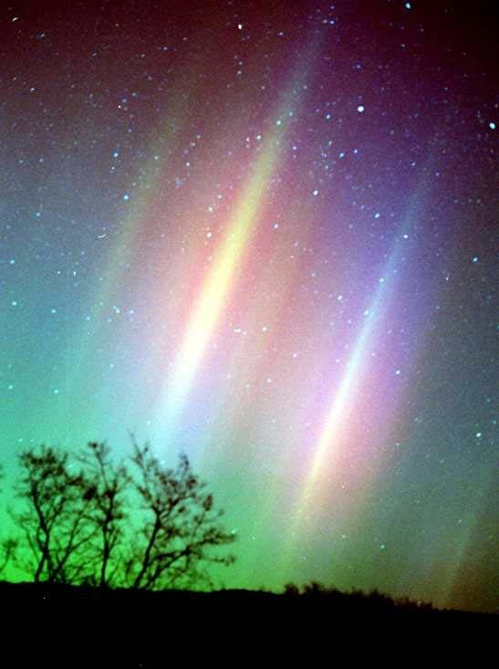
AURORA
Solar wind particles That leak into the Earth’s upper Atmosphere
Ionize gas atoms that Capture electrons Resulting in
An EMISSION SPECTRUM
Of rays
& beautiful curtains
CCO^{C}OS^{O}SM^{S}MI^{M}CIC^{I}N^{C}NE^{N}EO^{E}ON^{O}N^{N}

Slide 11

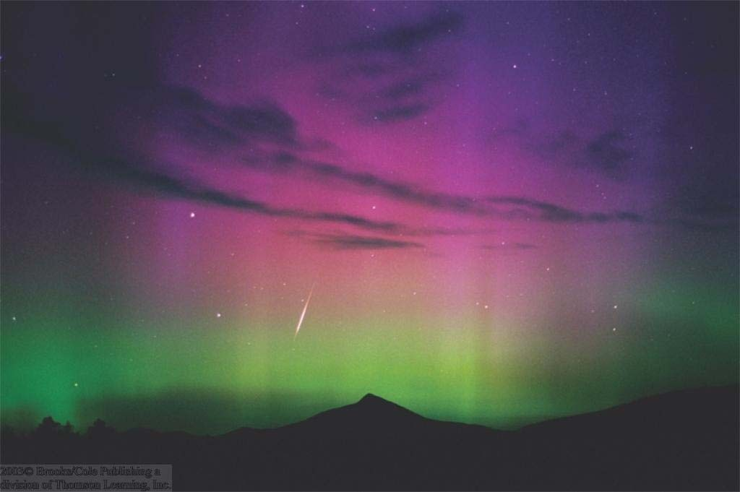
Another Aurora (Polar Light)
As high-energy particles leak into the lower magnetosphere, they excite molecules near the Earth’s magnetic poles, causing the aurora
Copyright © 2009 Pearson
Education, Inc.

Slide 12
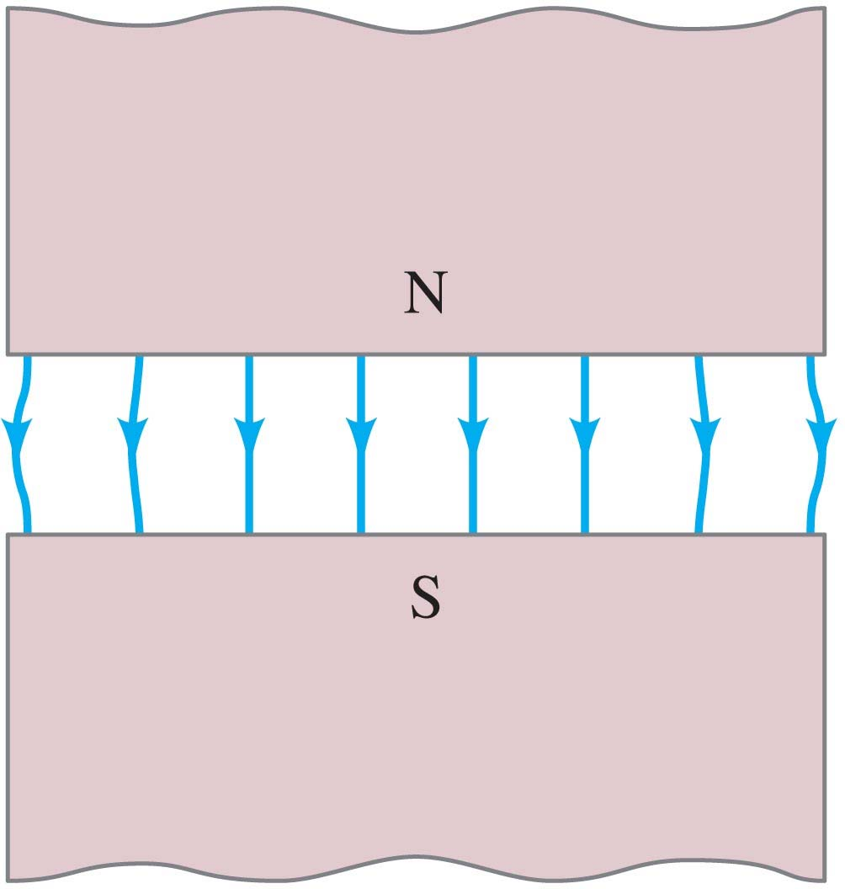
27-1 Magnets and Magnetic Fields
A uniform magnetic field is constant in magnitude and direction.
The field between these two wide poles is nearly uniform.

Slide 13
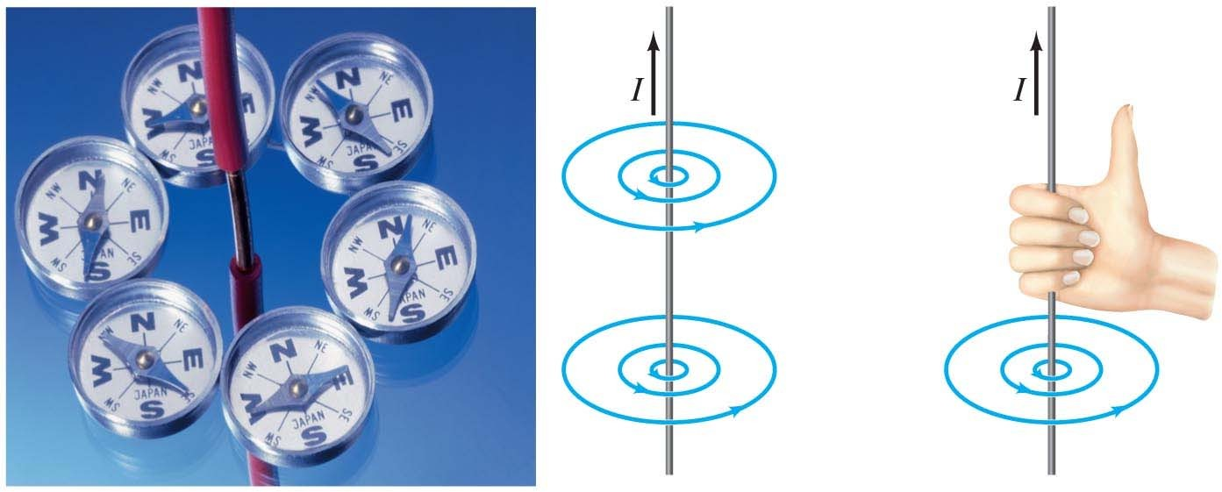
Experiment shows that an electric current produces a magnetic field. The direction of the field is given by a right-hand rule.

Slide 14
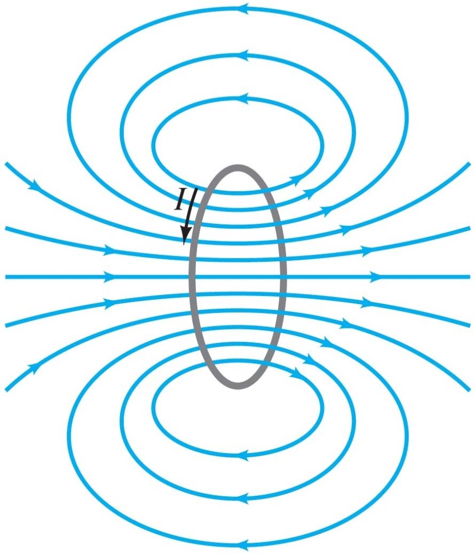
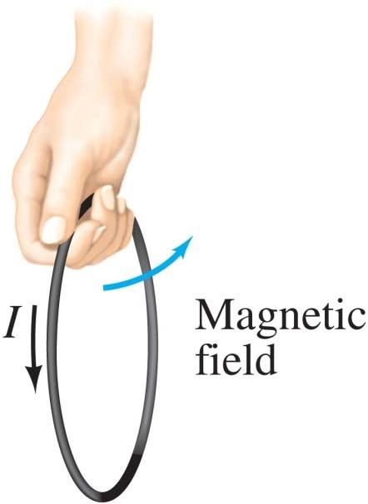
27-2 Electric Currents Produce Magnetic Fields
Here we see the field due to a current loop; the direction is again given by a right-hand rule.

Slide 15
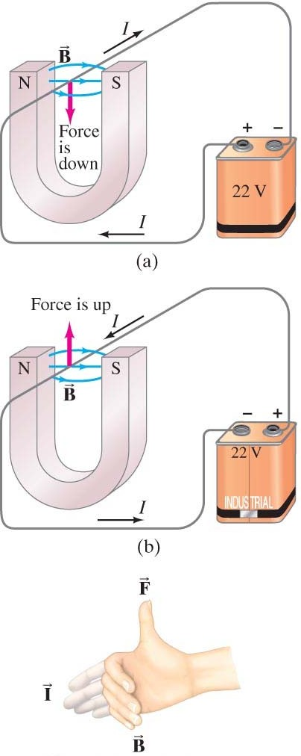
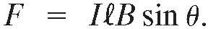
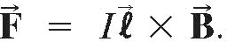

27-3 Force on an Electric Current in a Magnetic Field; Definition of B

A magnet exerts a force on a current-carrying wire. The direction of the force is given by a right-hand rule.
The force on the wire depends on the current, the length of the wire,
the magnetic field, and its orientation:
This last equation defines the magnetic field In vector notation:
$$dF=Idl×B$$

Slide 16
27-3 Force on an Electric Current in a Magnetic Field; Definition of B

Unit of B: the tesla, T:
1 T = 1 N/A·m. Ie from F=ilB-> B=F/il
Another unit sometimes used: the gauss (G):
1 G = 10⁻⁴ T.
Earth’s field is ~0.5G

Slide 17
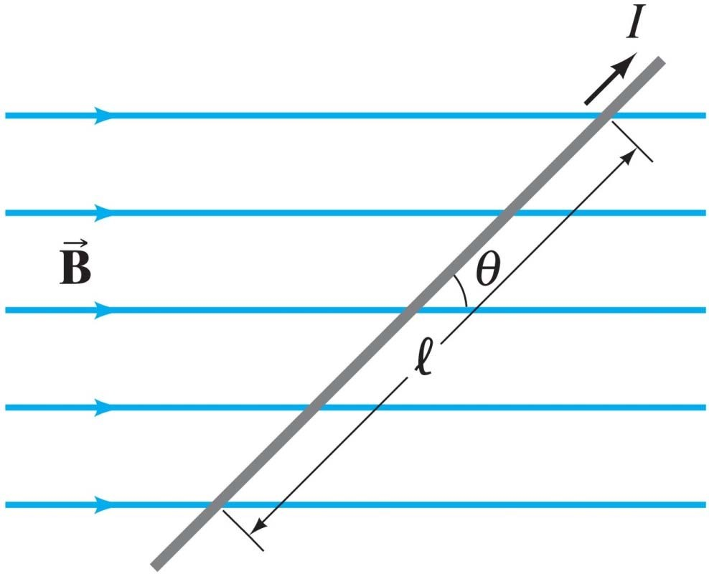
27-3 Force on an Electric Current in a Magnetic Field; Definition of B

Example 27-1: Magnetic Force on a current-carrying wire.
A wire carrying a 30-A current has a length  = 12 cm between the pole faces of a magnet at an angle θ = 60°, as shown.
The magnetic field is approximately uniform at
0.90 T. We ignore the field
beyond the pole pieces. What is the magnitude of the force on the wire?
CLASS

Slide 18
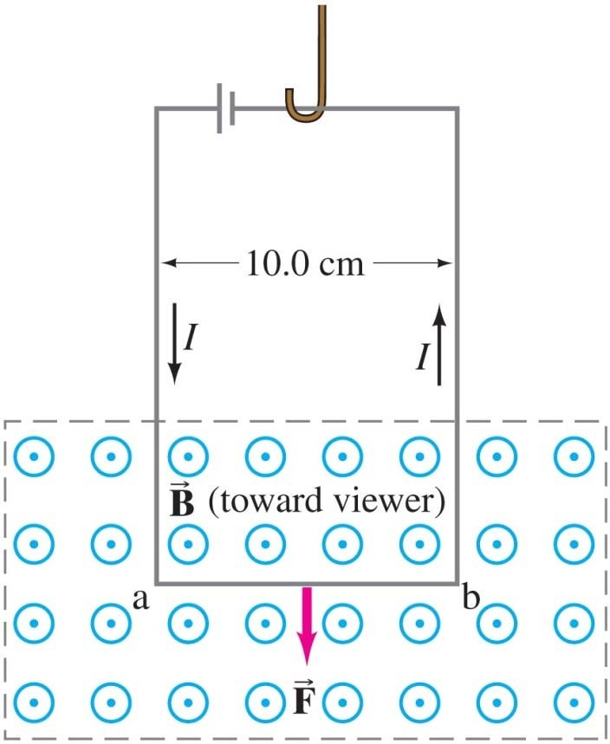
27-3 Force on an Electric Current in a Magnetic Field; Definition of B

Example 27-2: Measuring a magnetic field.
A rectangular loop of wir_{B}e hangs vertically as shown. A magnetic field is directed horizontally, perpendicular to the wire, and points out of the page at all points. The
magnetic field is very nearly uniform along
the horizontal portion of wire ab (length =
10.0 cm) which is near the center of the gap of a large magnet producing the field. The top portion of the wire loop is free of the field. The loop hangs from a balance which measures a downward magnetic force (in addition to the gravitational force) of F = 3.48 x 10⁻² N when the wire carries a current I =
0.245 A. What is the magnitude of the magnetic field B?
class
Θ=90 F=ilB or
B=F/il =1.42T

Slide 19
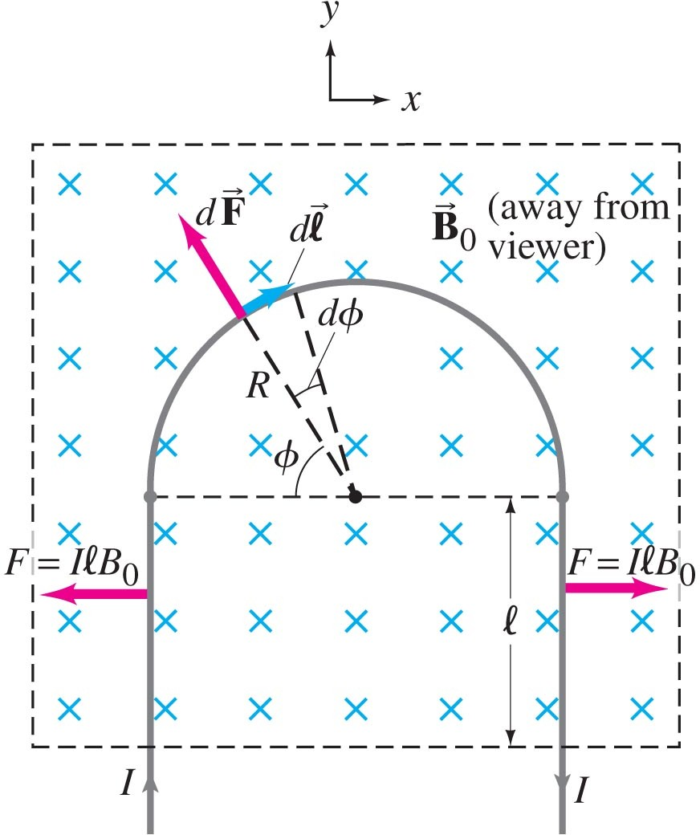
27-3 Force on an Electric Current in a Magnetic Field;
Definition
of

B
Example 27-3: Magnetic Force on a semicircular wire.
A rigid wire, carrying a current I, consists of a semicircle of radius R and two straight portions as shown. The wire lies in a plane perpendicular to a uniform magnetic field B₀ Note choice x and y axis. The straight portions each have
length  within the field. Determine the
net force on the wire due to the magnetic
field.
Note symmetry cancellations all x Components of dF and these
Only y component of dF, dFsinφ
Αlso dl=Rdφ −> ΣdFsinφ & dF=iB₀Rdφ
π
F = ∫ dF
Copyright © 2009 Pearson Education, Inc. 0
sin ϕ = IB ₀ R ∫ sin ϕ d ϕ = 2 IB ₀ R
0
π

Slide 20
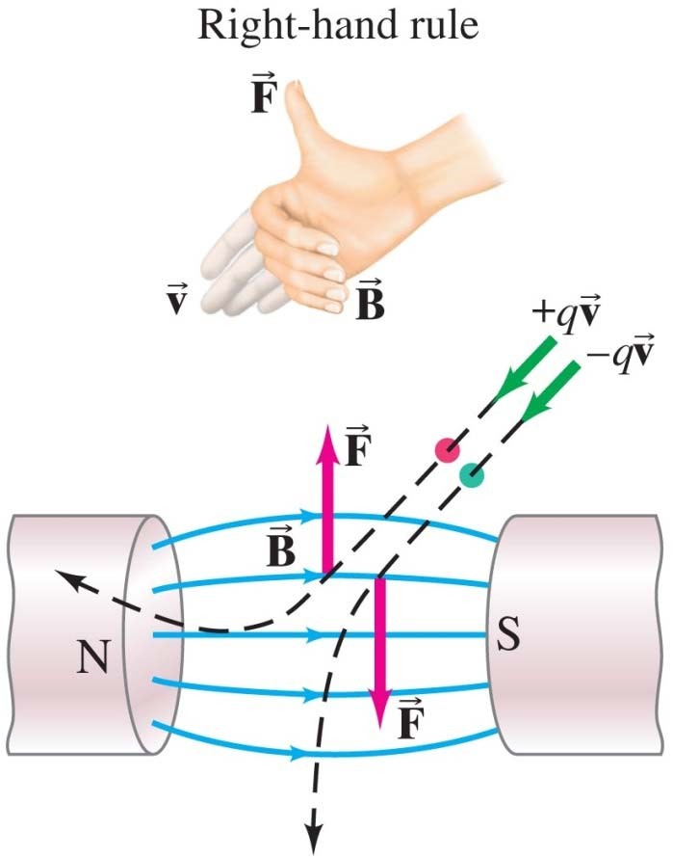
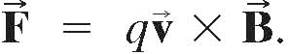
27-4 Force on an Electric Charge Moving in a Magnetic Field
The force on a moving charge is related to the force on a current:
Ie. Assume i=Q/t=Nq/t N number of charges
And v velocity so they travel in t a length l=vt
Thus F=ilxB=N(q/t)vt xB =NqvxB So for one charge.
Once again, the direction is given by a right-hand rule.
part of: THE LORENTZ FORCE

Slide 21
27-4 Force on an Electric Charge Moving in a Magnetic Field
Conceptual Example 27-4: Negative charge near a magnet.
A negative charge -Q is placed at rest near a magnet. Will the charge begin to move? Will it feel a force? What if the charge were positive, +Q?
CLASS?

Slide 22
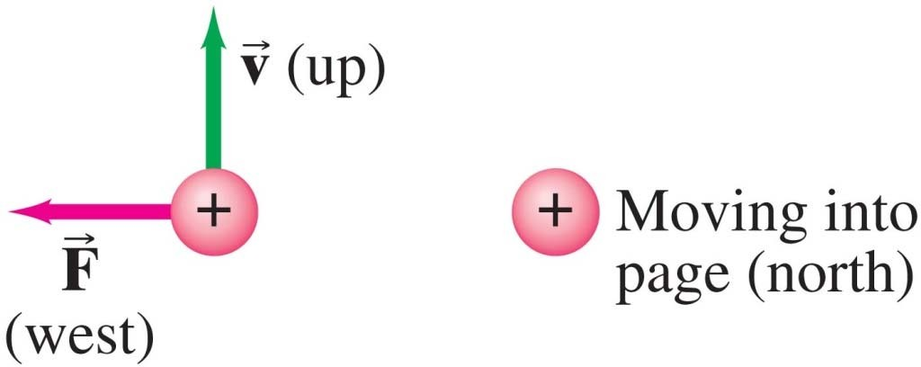
Example 27-5: Magnetic force on a proton.
A magnetic field exerts a force of 8.0 x 10⁻¹⁴ N toward the west on a proton moving vertically upward at a speed of
5.0 x 10⁶ m/s. When moving horizontally in a northerly direction, the force on the proton is zero. Determine the magnitude and direction of the magnetic field in this region. (The charge on a proton is q = +e = 1.6 x 10⁻¹⁹ C.)
Direction of B? Angle θ ? B=F/qv=0.1T

Slide 23
Example 27-6: Magnetic force on ions during a nerve pulse.
Estimate the magnetic force due to the Earth’s magnetic field on ions crossing a cell membrane during an action potential. Assume the speed of the ions is 10⁻² m/s. B~0.5 G ~10⁻⁴ T
F~qvB ~10⁻¹⁹C 10⁻² m/s x10⁻⁴T =10⁻²⁵N

Slide 24
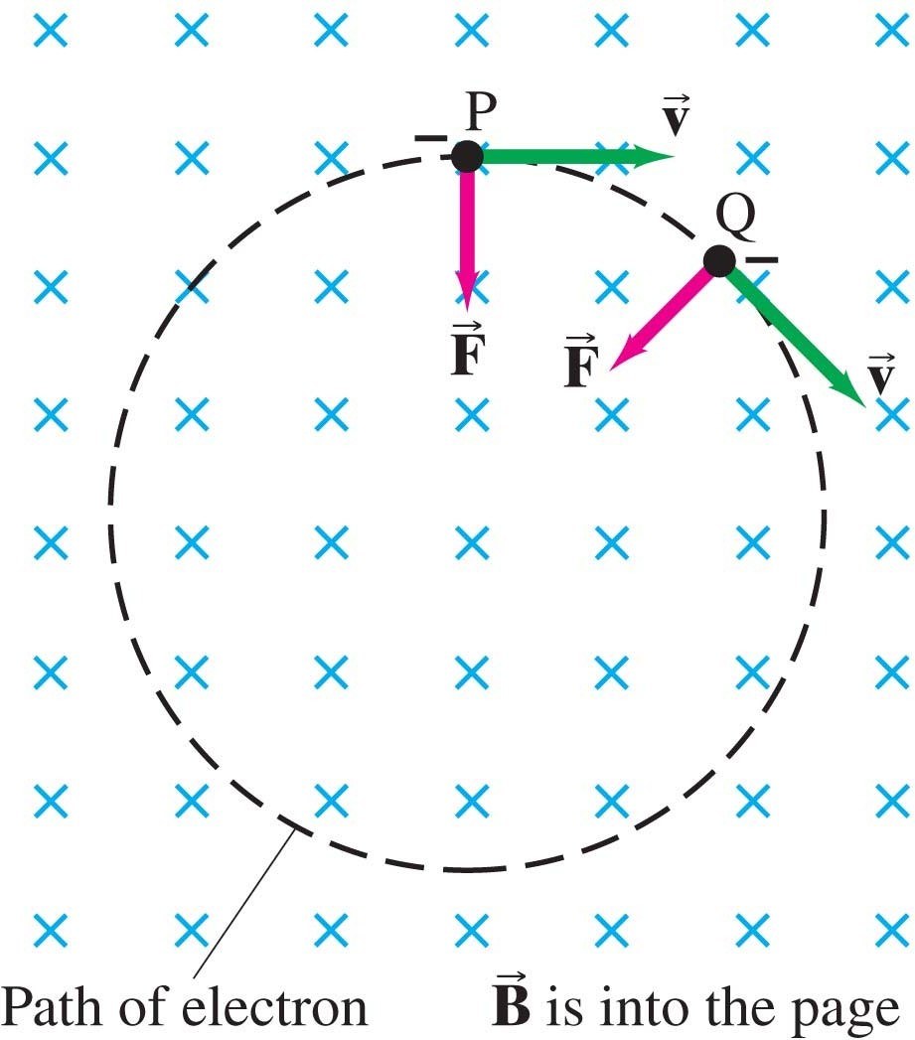
If a charged particle is moving perpendicular to a uniform magnetic field, its path will be a circle. NOTE Perpendicular!!!
Example 27-7: Electron’s path in a uniform magnetic field.
An electron travels at 2.0 x 10⁷ m/s in a plane perpendicular to a uniform 0.010-T magnetic field. Describe its path quantitatively.
Ie radius of path, period and Frequency of orbit
CLASS?

Slide 25
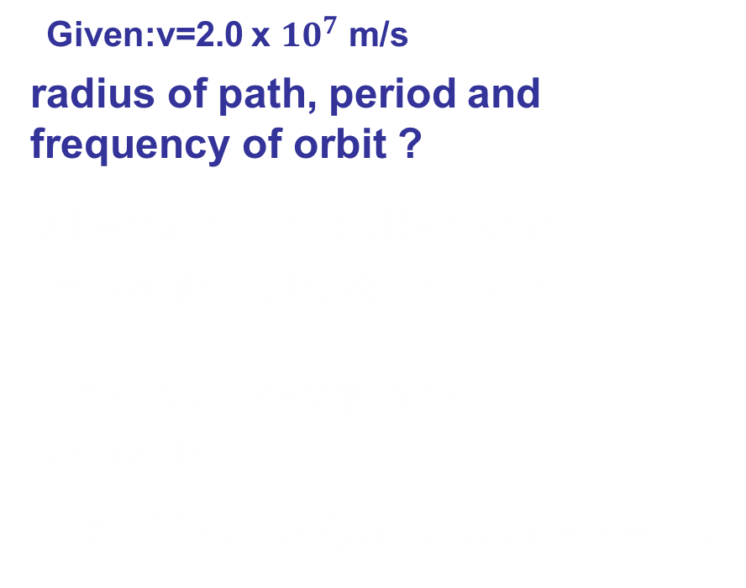
27-4 Force on an Electric Charge Moving in a Magnetic Field
Given:v=2.0 x ${10}^{7}$ m/s B=0.010T
radius of path, period and frequency of orbit ?
ΣF=ma-> so qvB=mv² /r r=mv/qB (v, B, & r constant!)
T=2πr/v =2πr/qBr/m = 2πm/qB
f =qB/2πm -> Cyclotron frequency

Slide 26
Problem solving: Magnetic fields – things to remember:
The magnetic force is perpendicular to the magnetic field direction.
The right-hand rule is useful for determining directions.
Equations in this chapter give magnitudes only. The right-hand rule gives the direction.

Slide 27
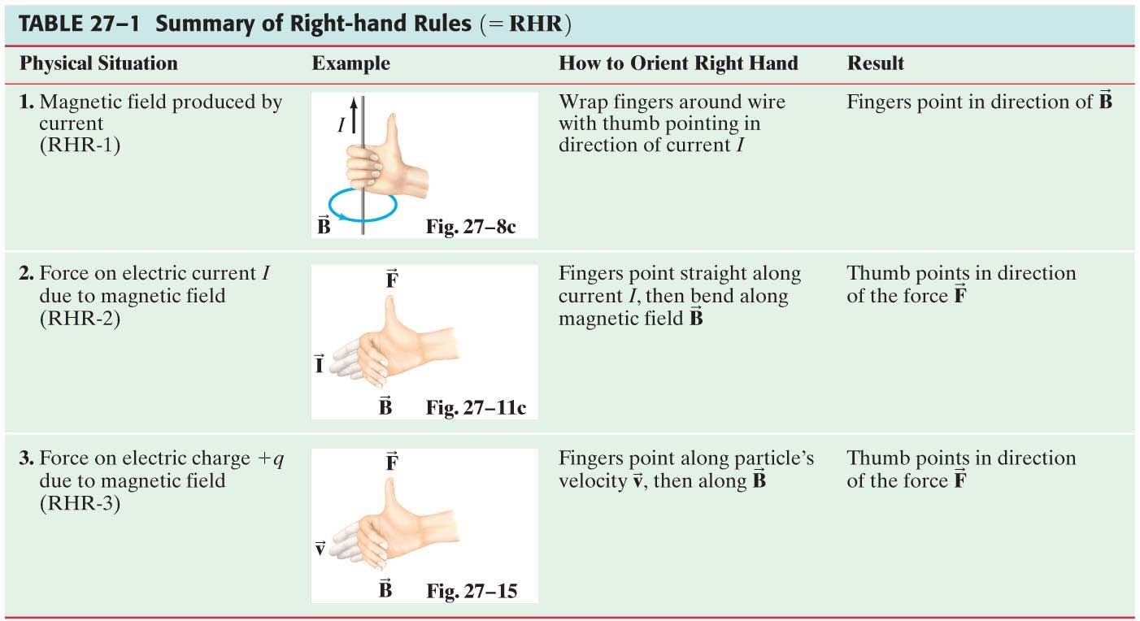
27-4 Force on an Electric Charge Moving in a Magnetic Field

Slide 28
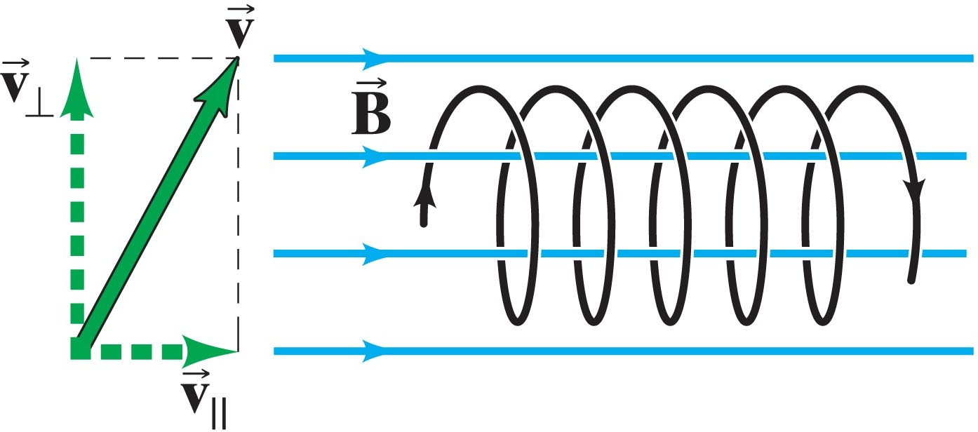
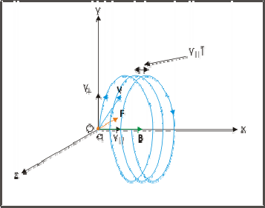
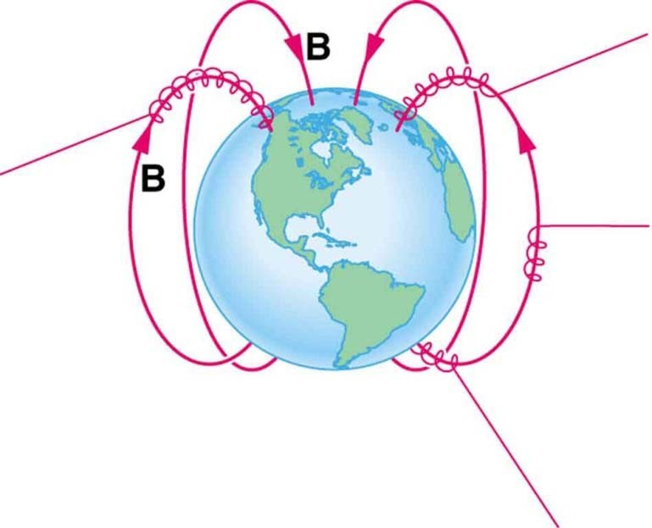
27-4 Force on an Electric Charge Moving in a Magnetic Field
Conceptual Example 27-9: A helical path.
What is the path of a charged particle in a uniform magnetic field if its velocity is not perpendicular to the magnetic field?

Slide 29
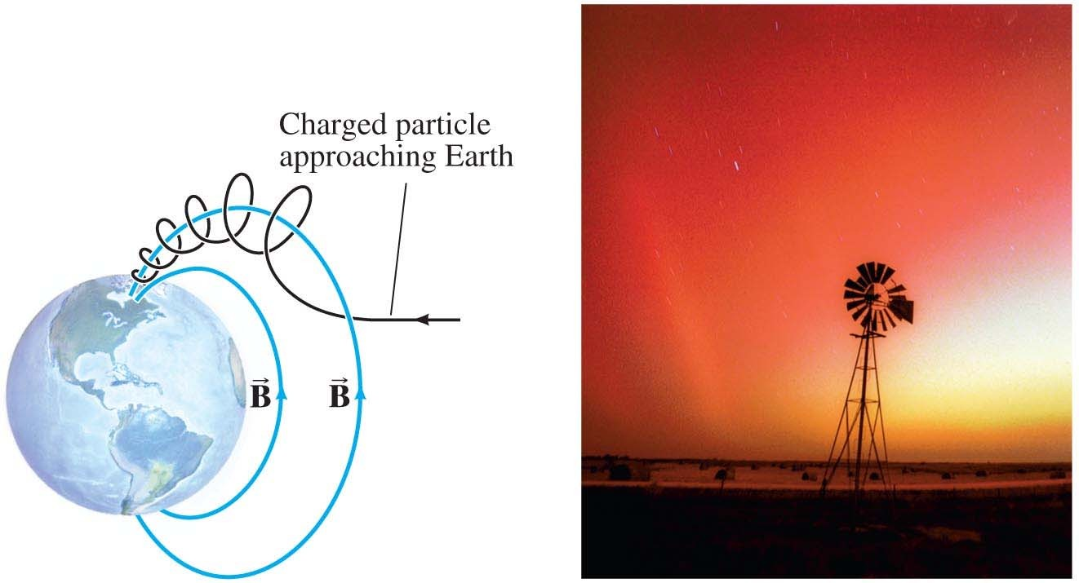
27-4 Force on an Electric Charge Moving in a Magnetic Field
The aurora borealis (northern lights) is caused by charged particles from the solar wind spiraling along the Earth’s magnetic field, and colliding with air molecules.

Slide 30
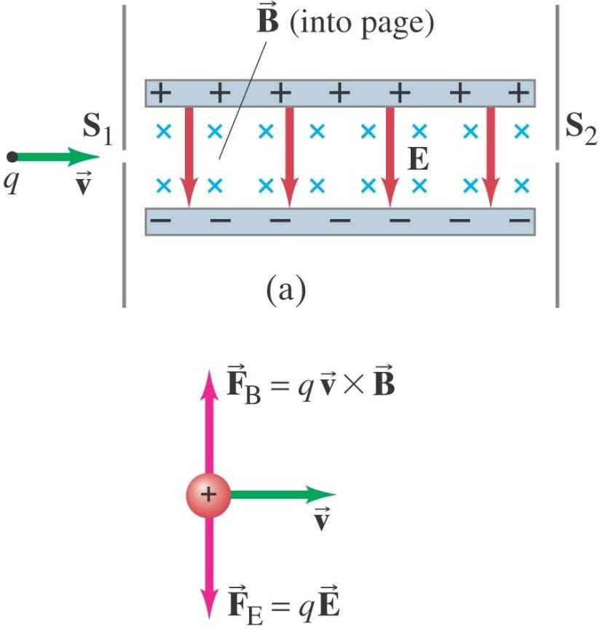
Conceptual Example 27-10: Velocity selector, or filter: crossed
 
E and B fields.
Some electronic devices and experiments need a beam of charged particles all moving at nearly the same velocity. This can be achieved using both a uniform electric field and a uniform magnetic field, arranged so they are at right angles to each other. Particles of charge q pass through slit S₁ and enter the region where B points into the page and E points down
from the positive plate toward the negative plate. If the particles enter with different velocities, show how this device “selects” a particular velocity, and
determine what this velocity is.
ΣF=0
qvB=qE get thru! Only! v=E/B!
CLASS?

Slide 31
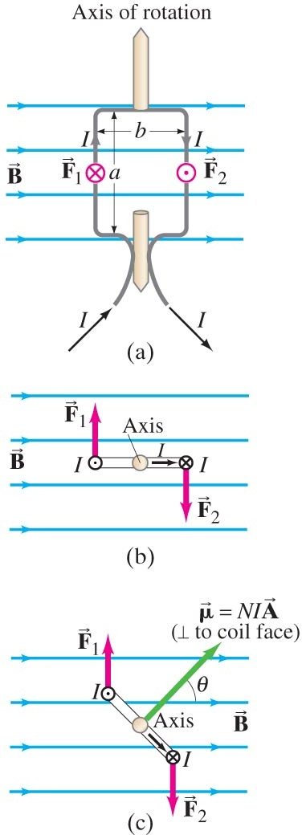
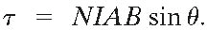
27-5 Torque on a Current Loop; Magnetic Dipole Moment
The forces on opposite sides of a current loop will be equal and opposite (if the field is uniform and the loop is symmetric), but there may be a torque.
The magnitude of the torque is given by

Slide 32
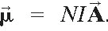

27-5 Torque on a Current Loop; Magnetic Dipole Moment
The quantity NIA is called the magnetic dipole moment, μ:
$τ$=$μ×B$
The potential energy of the loop depends on its orientation in the field:

Slide 33
27-5 Torque on a Current Loop; Magnetic Dipole Moment
Example 27-11: Torque on a coil.
A circular coil of wire has a diameter of
20.0 cm and contains 10 loops. The current in each loop is 3.00 A, and the coil is placed in a 2.00-T external magnetic field. Determine the maximum and minimum torque exerted on the coil by the field.

Slide 34
27-5 Torque on a Current Loop; Magnetic Dipole Moment
Example 27-12: Magnetic moment of a hydrogen atom.
Determine the magnetic dipole moment of the electron orbiting the proton of a hydrogen atom at a given instant, assuming (in the Bohr model) it is in its ground state with a circular orbit of radius r = 0.529 x 10⁻¹⁰ m. [This is a very rough picture of atomic structure, but nonetheless gives an accurate result.]

Slide 35
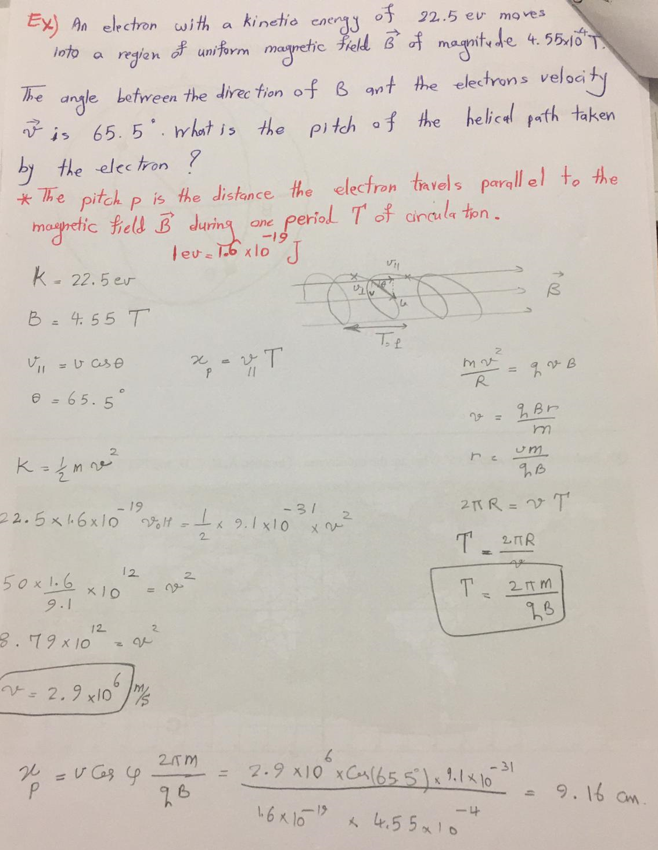

Slide 36
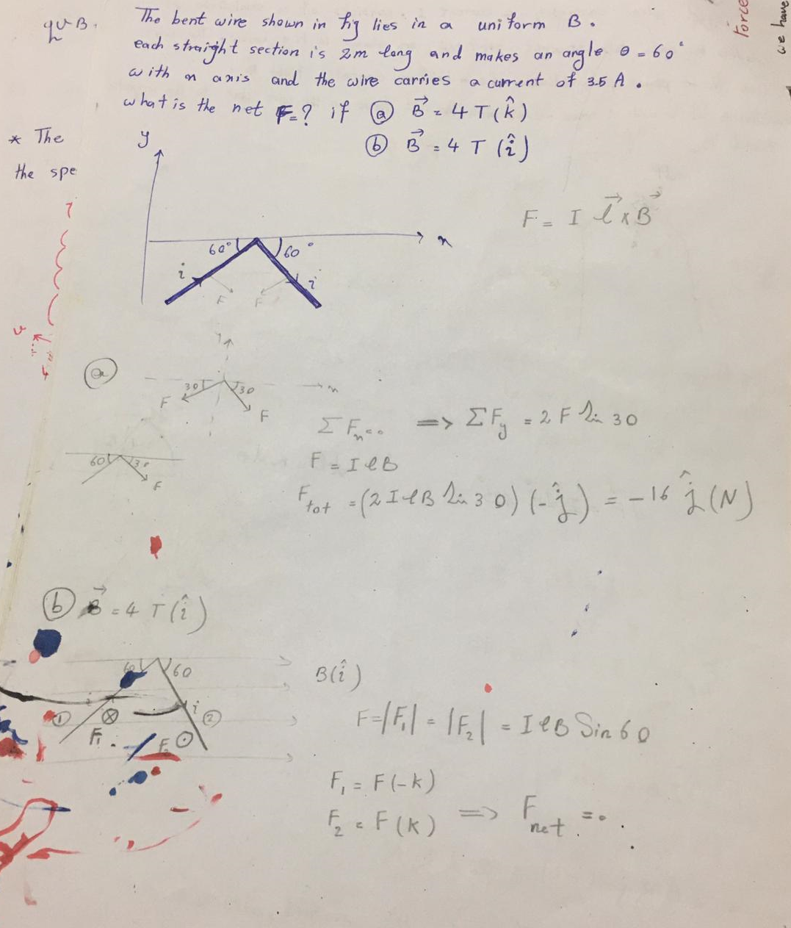

Slide 37
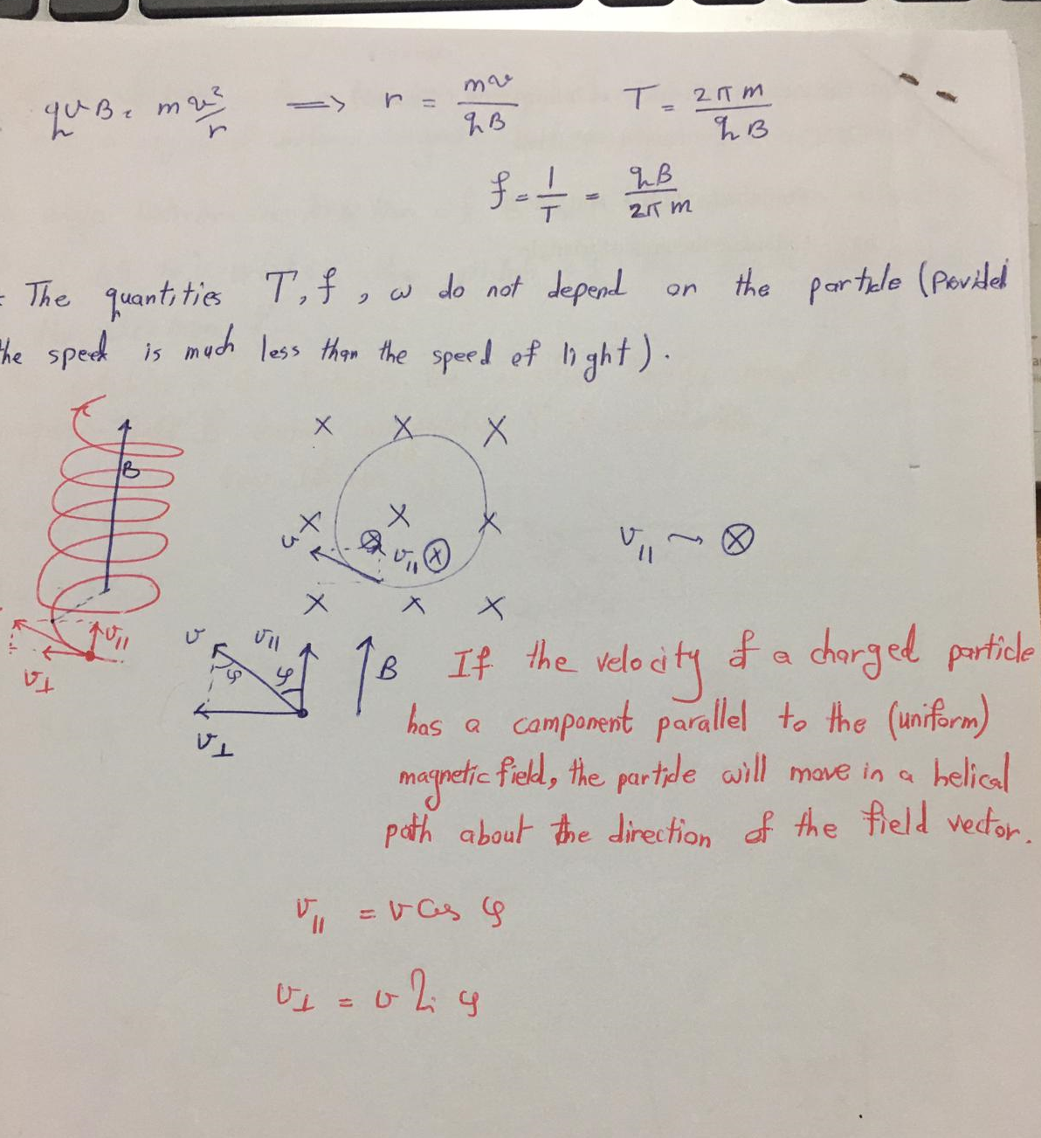

Slide 38
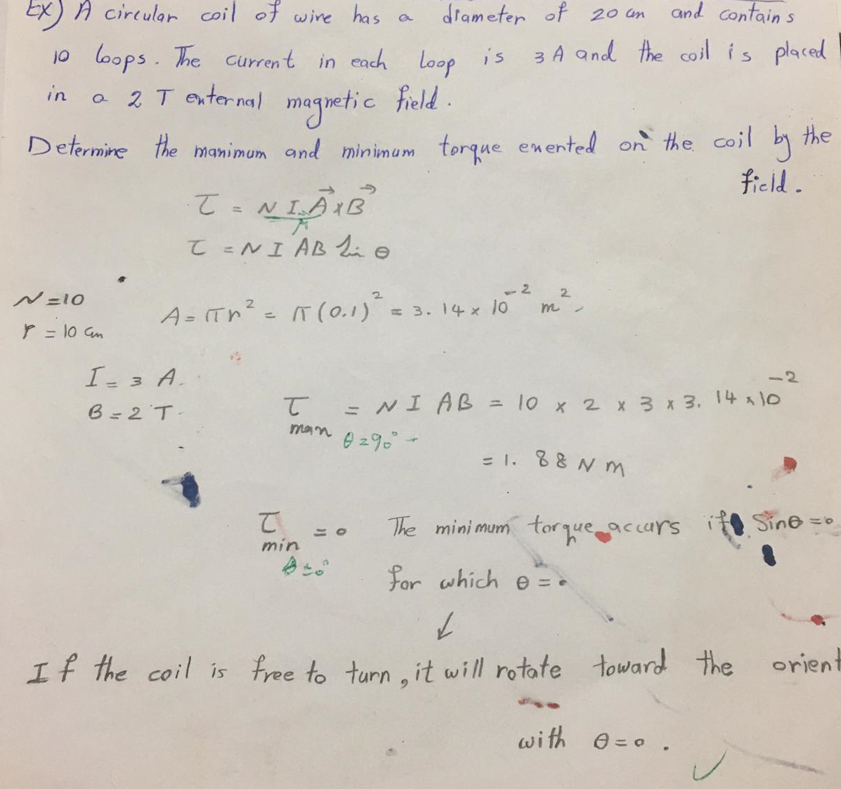

Slide 39
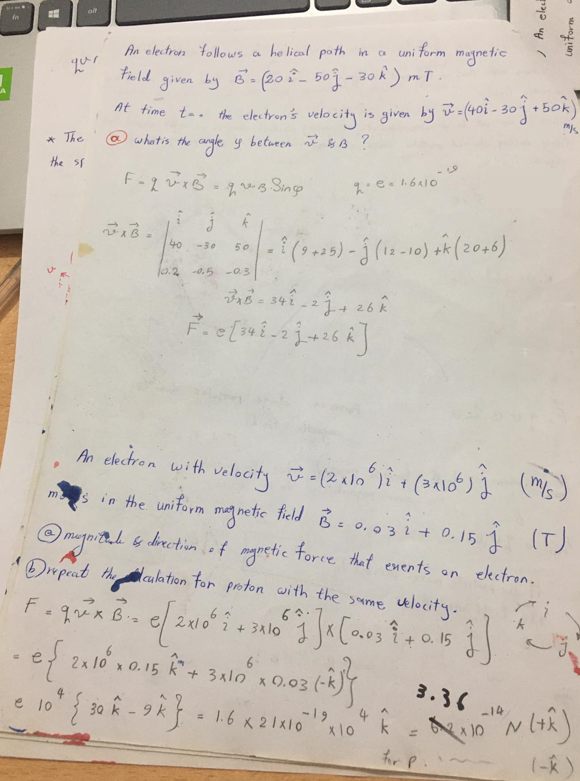

Slide 40
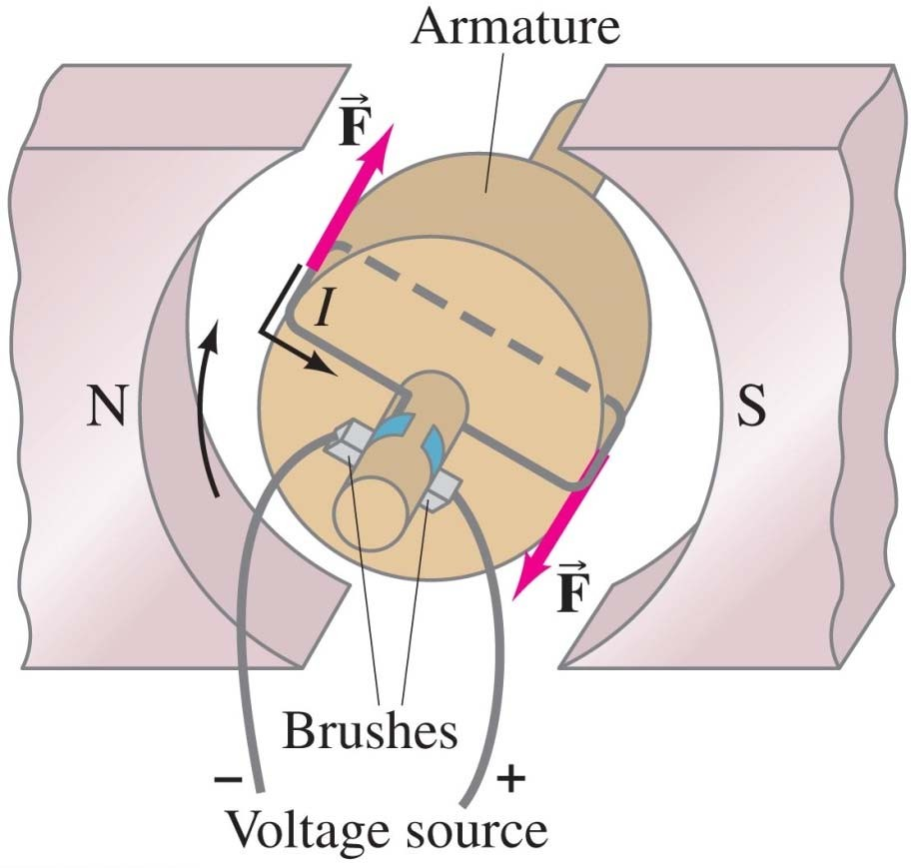
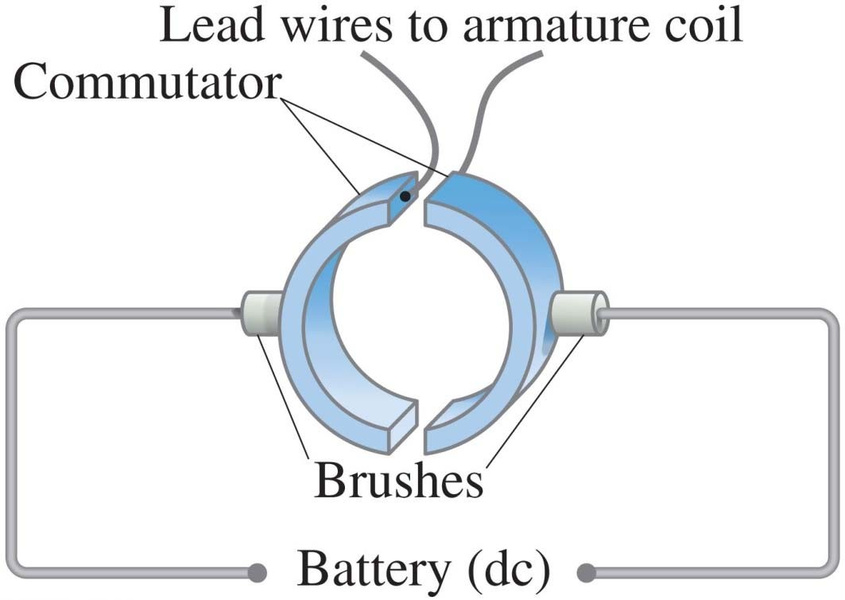
27-6 Applications: Motors, Loudspeakers, Galvanometers
An electric motor uses the torque on a current loop in a magnetic field to turn magnetic energy into kinetic energy.

Slide 41
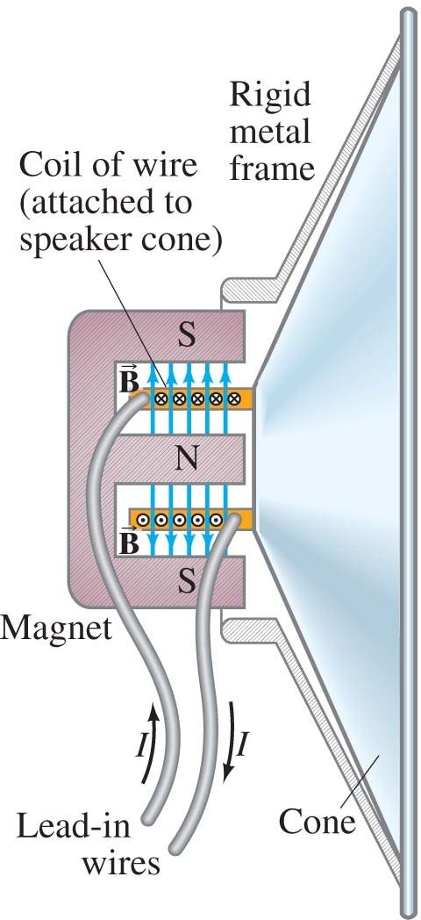
27-6 Applications: Motors, Loudspeakers, Galvanometers
Loudspeakers use the principle that a magnet exerts a force on a current-carrying wire to convert electrical signals into mechanical vibrations, producing sound.

Slide 42
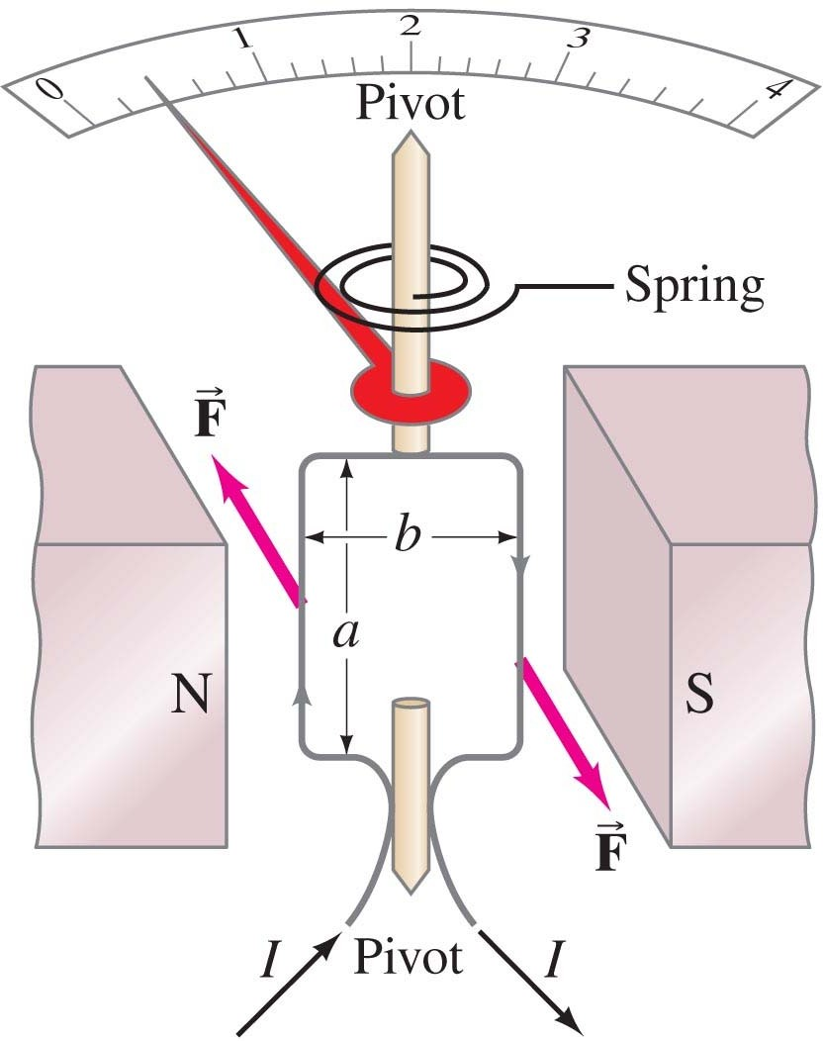
27-6 Applications: Motors, Loudspeakers, Galvanometers
A galvanometer takes advantage of the torque on a current loop to measure current; the spring constant is calibrated so the scale reads in amperes.

Slide 43
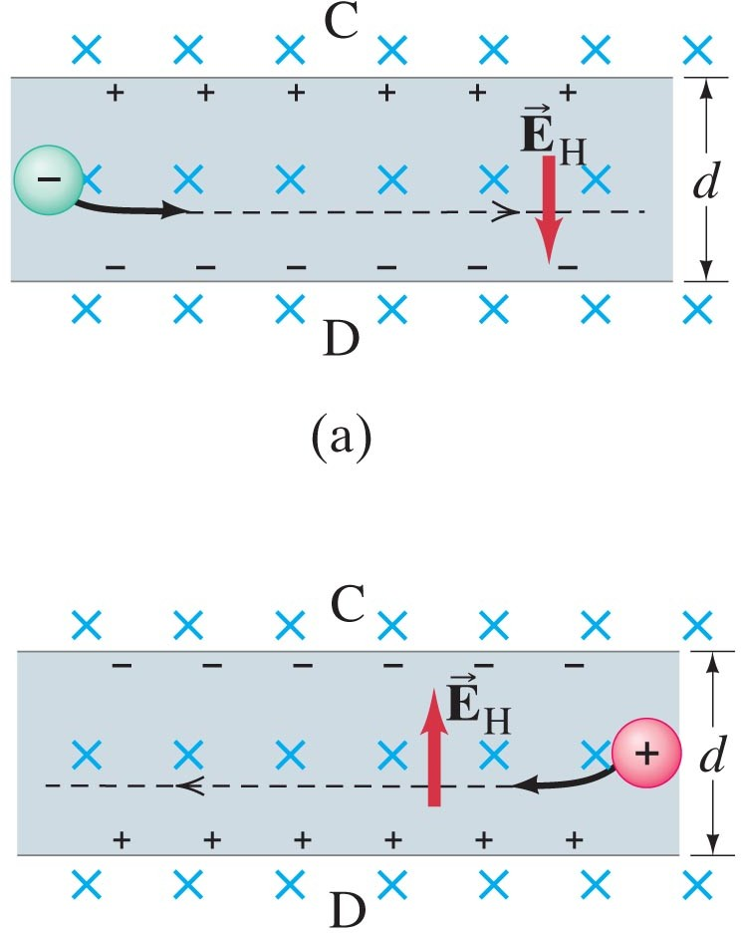
27-8 The Hall Effect->Hall Probe to measure magnetic fields
When a current-carrying wire is placed in a magnetic field, there is a sideways force on the electrons in the wire. This tends to push them to one side and results in a potential difference from one side of the wire to the other; this is called the Hall effect. The emf differs in sign depending on the sign of the charge carriers; this is how it was first determined that the charge carriers in ordinary conductors are
ΣF=0-> eE_{H} =ev_{d}B
negatively charged.
EMF(V) =E_{H}d =v_{d}Bd

Slide 44
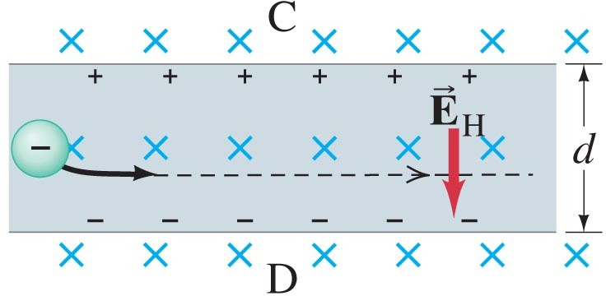
27-8 The Hall Effect
Example 27-13: Drift velocity using the Hall effect.
A long copper strip 1.8 cm wide and 1.0 mm thick is placed in a 1.2-T magnetic field. When a steady current of 15 A passes through it, the Hall emf is measured to be
1.02 μV. Determine the drift velocity of the electrons and the density of free (conducting) electrons (number per unit volume) in the copper.

Slide 45



